Slide 1
Новый 9V-battery контроллер совместимый с Wi-Fi модулем TBOS-BT

Slide 2
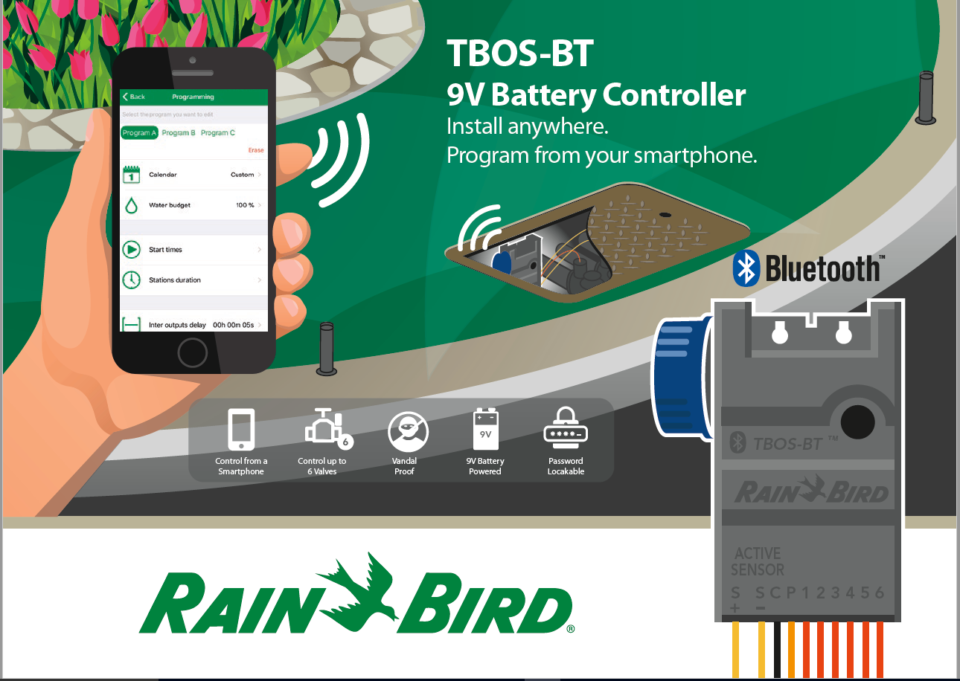

Slide 3
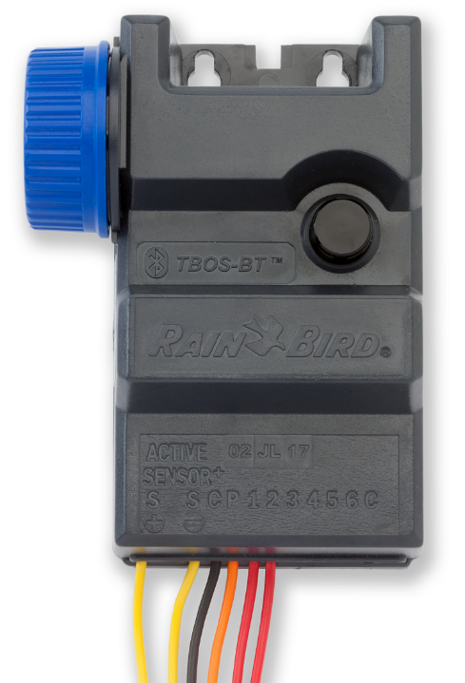
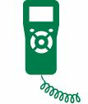
9В Контроллер с батарейным питанием TBOS-BT
Устанавливается где угодно
Антивандальный
Защита IP68
Контролирует до 6 зон
Совместим со старыми передатчиками
Notes:
The TBOS-BT is a commercial-grade, battery-operated controller which can be installed anywhere. It easily mounts inside a valve box and because there is no controller interface the TBOS-BT is vandal-proof
It is also IP 68 rated. This designation means it’s sealed to prevent dust and dirt from entering the controller, and is protected from long term immersion in water.
Primary applications for the TBOS-BT are in street and highway medians, roundabouts, parks, or anywhere irrigation is needed but there is no AC power, or when only temporary irrigation will be needed to help establish plants, or on a construction site.
The TBOS-BT can help earn the Outdoor Water Use Credit on LEED projects by helping to satisfy the requirement for only temporary irrigation to be used to establish plants over a two-year period.

Slide 4
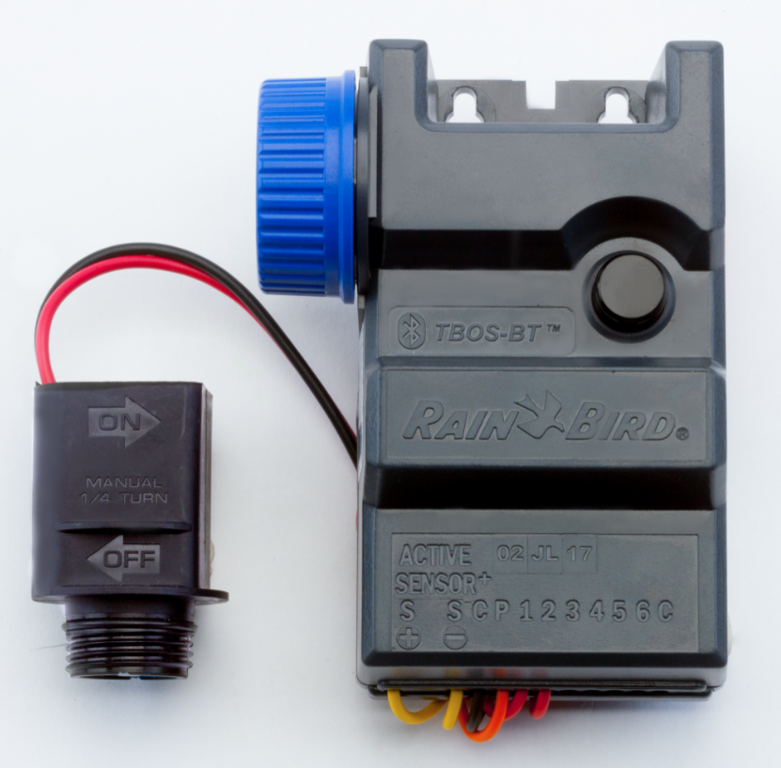
Что нового в TBOS-BT?
Такая же функциональность, что и у TBOSII
Возможность радио соединения
Централизация с IQ
Конкурентоспособная цена
+ Подключение и управление через Bluetooth

Slide 5
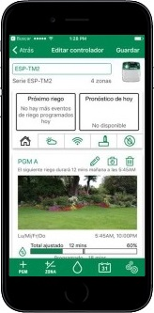
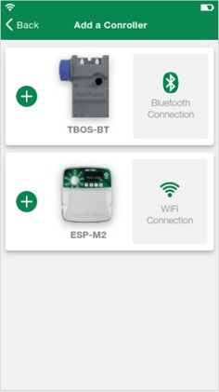
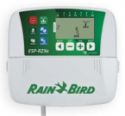
TBOS-BT в приложение Rain Bird
Настраивайте и управляйте вручную со смартфона
Rain Bird App
Одно приложение
Тоже, что и для LNK Wi-Fi
Управляйте сотнями контроллеров разных моделей
Возможность создавать группы
ESP-RZXe
Notes:
The biggest change from the TBOS-II to the TBOS-BT is now the controller can be programmed and manually operated from a smartphone using the Rain Bird App. This is the same app used for the ESP-TM2 and ESP-Me with the LNK WiFi Module.
Users can create programs that adjust monthly and can turn off in winter months.
Users can also set up a password so you can restrict access.

Slide 6
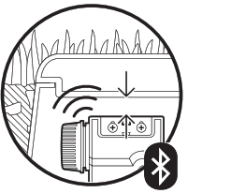
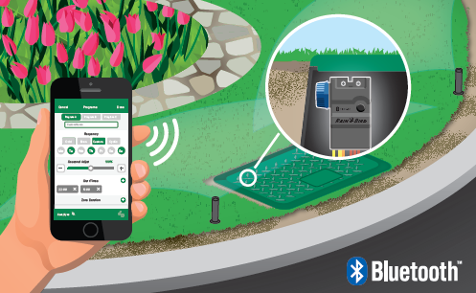
Bluetooth
Максимальная дистанция 12 м
Notes:
The TBOS-BT uses a Bluetooth connection, instead of wireless internet network, to communicate with the smartphone. Once the controller is paired with the Rain Bird App users can create and send programs to the controller.
Since Bluetooth uses a radio frequency to communicate, the strength of the signal between the controller and the smartphone is dependent certain conditions: how deep the controller is buried, valve box material, and the model of smartphone being used. In optimal conditions, where line of sight is established with the controller the range is up to 40ft.
The controller’s battery life is also displayed in the Rain Bird app making it easy to check if the battery needs to be replaced.
he biggest change from the TBOS-II to the TBOS-BT is now the controller can be programmed and manually operated from a smartphone using the Rain Bird App. This is the same app used for the ESP-TM2 and ESP-Me with the LNK WiFi Module.
The TBOS-BT uses a Bluetooth connection, instead of wireless internet network, to communicate with the smartphone. Once the controller is paired with the Rain Bird App users can create and send programs to the controller.
Since Bluetooth uses a radio frequency to communicate, the strength of the signal between the controller and the smartphone is dependent certain conditions: how deep the controller is buried, valve box material, and the model of smartphone being used. In optimal conditions, where line of sight is established with the controller the range is up to 40ft.
The controller’s battery life is also displayed in the Rain Bird app making it easy to check if the battery needs to be replaced.

Slide 7
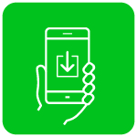
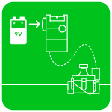
Как это работает?
Загрузите приложение
Установите контроллер
Подключитесь и настройте контроллер
Поливайте!
Notes:
How it works:
To get started using the TBOS-BT, first download the Rain Bird App from the Apple store or Google Play.
This is the same app that’s used for the ESP-TM2 and ESP-Me controllers with LNK WiFi Module installed. If you already have that app installed you don’t have to download it again.
Insert 9V battery into the compartment of the TBOS-BT and install the controller
On the App you will select the TBOS-BT, and pair the phone to the controller. You are now ready to program the controller. Once you have completed the programming you will transmit or send this information to the controller.
You are now ready to irrigate.

Slide 8
Практическая часть
КОНТРОЛЛЕР TBOS BLUETOOTH

Slide 9
Скачайте и установите приложение Rain Bird
Rain Bird App
Минимальные требования:
Android 4.4 (KitKat)
Apple iOS 8
Notes:
The TBOS-BT provides flexible programming with many options:
There are three independent programs.
Each program can have up to eight start times per day.
There are four water day options – custom day selection, even or odd days and cyclic
Delay watering from 1 to 14 days, when using a wired RSD Rain Sensor
Monthly seasonal adjust can reduce the number of trips to the controller by allowing you to increase or decrease the program times based on the season. Time can be set to zero if the program needs to be shut off in the winter months.

Slide 10
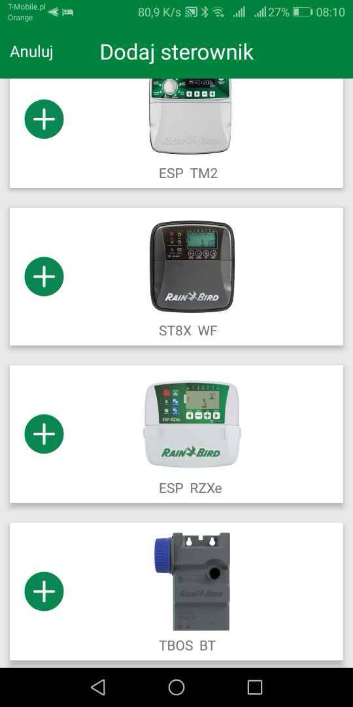
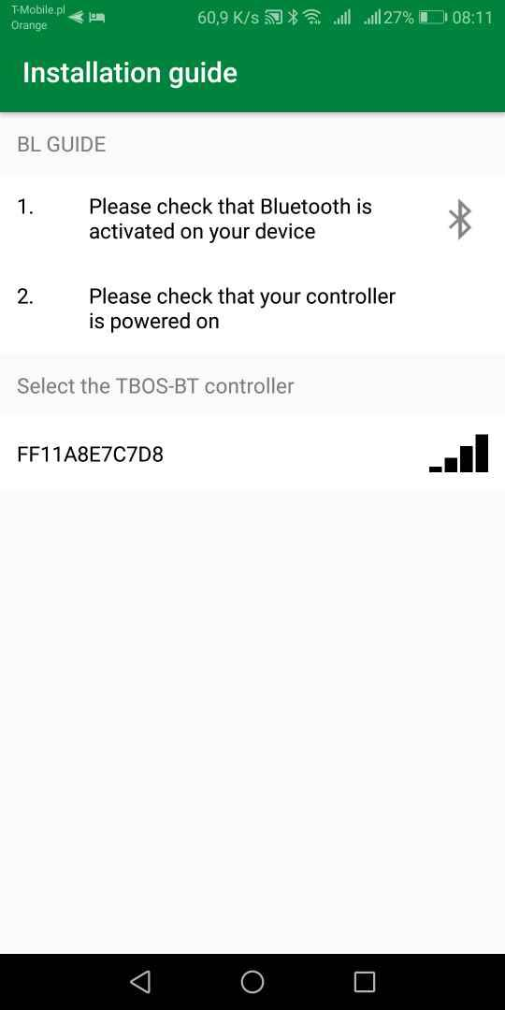
Подключите TBOS BT
Notes:
The TBOS-BT provides flexible programming with many options:
There are three independent programs.
Each program can have up to eight start times per day.
There are four water day options – custom day selection, even or odd days and cyclic
Delay watering from 1 to 14 days, when using a wired RSD Rain Sensor
Monthly seasonal adjust can reduce the number of trips to the controller by allowing you to increase or decrease the program times based on the season. Time can be set to zero if the program needs to be shut off in the winter months.

Slide 11
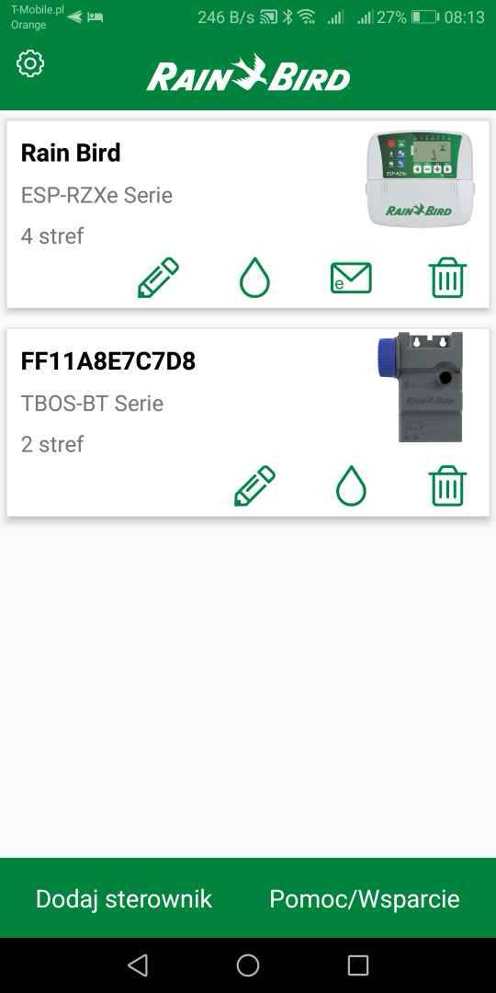
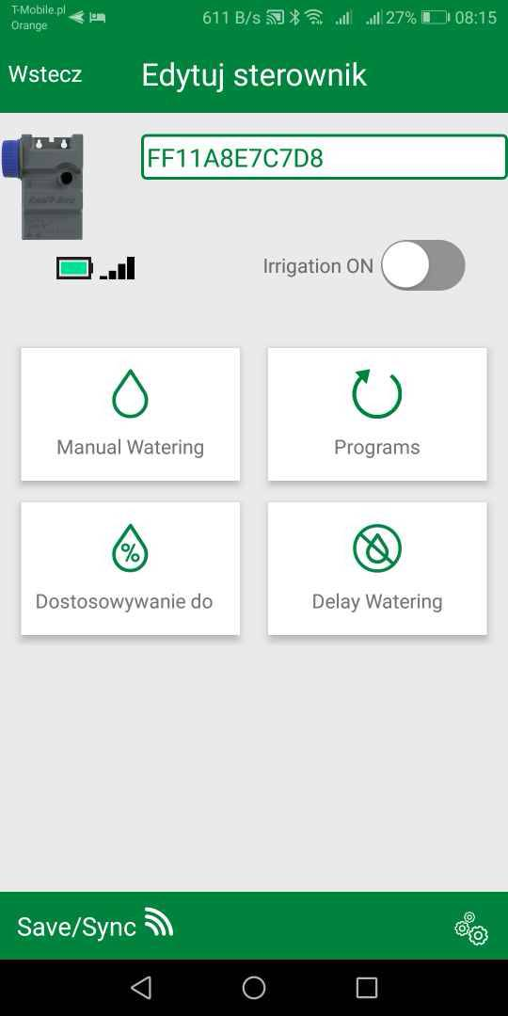
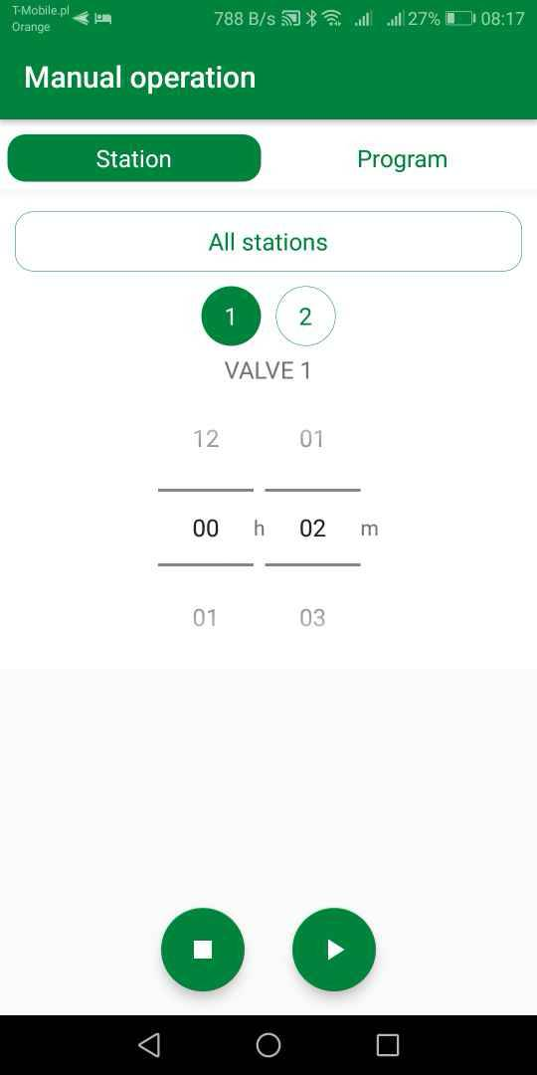
Настройте контроллер и запустите вручную
Notes:
The TBOS-BT provides flexible programming with many options:
There are three independent programs.
Each program can have up to eight start times per day.
There are four water day options – custom day selection, even or odd days and cyclic
Delay watering from 1 to 14 days, when using a wired RSD Rain Sensor
Monthly seasonal adjust can reduce the number of trips to the controller by allowing you to increase or decrease the program times based on the season. Time can be set to zero if the program needs to be shut off in the winter months.

Slide 12
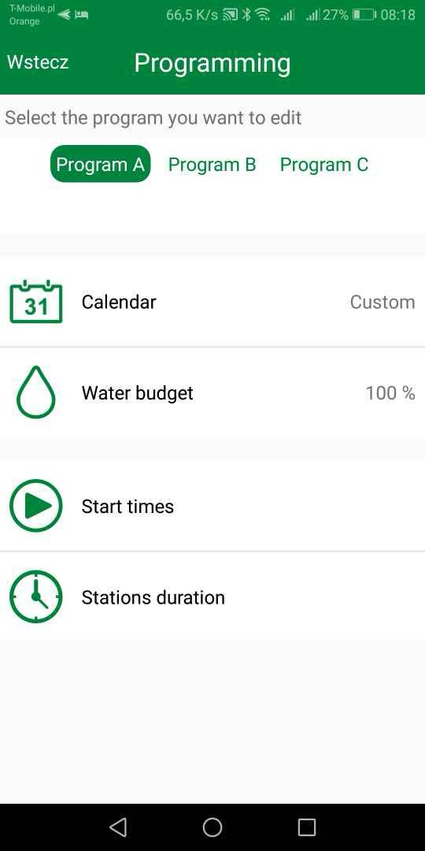
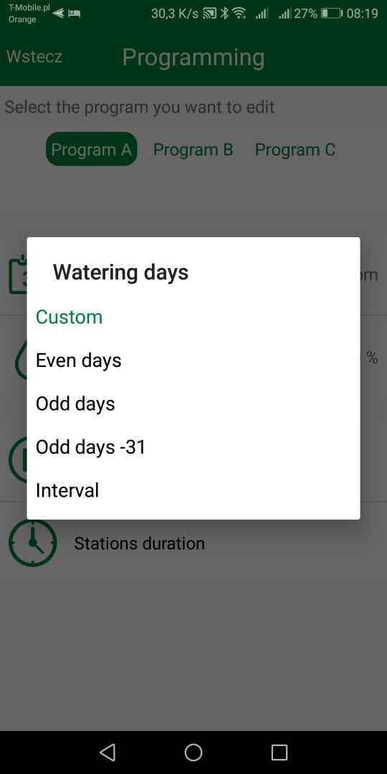
Настройте программы и сохраните
Notes:
The TBOS-BT provides flexible programming with many options:
There are three independent programs.
Each program can have up to eight start times per day.
There are four water day options – custom day selection, even or odd days and cyclic
Delay watering from 1 to 14 days, when using a wired RSD Rain Sensor
Monthly seasonal adjust can reduce the number of trips to the controller by allowing you to increase or decrease the program times based on the season. Time can be set to zero if the program needs to be shut off in the winter months.

Slide 13
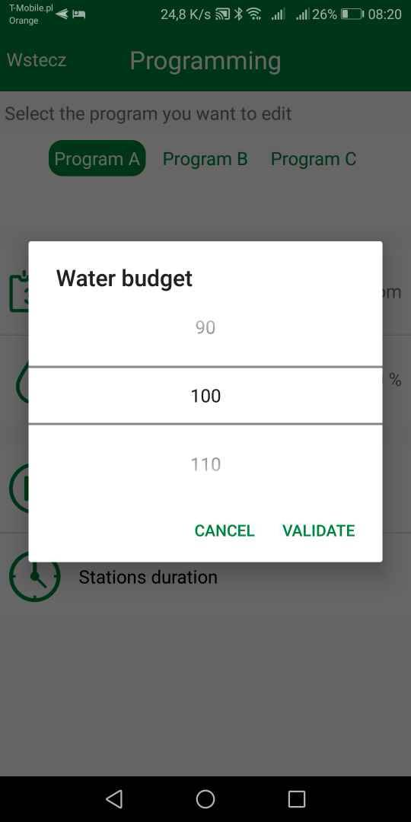
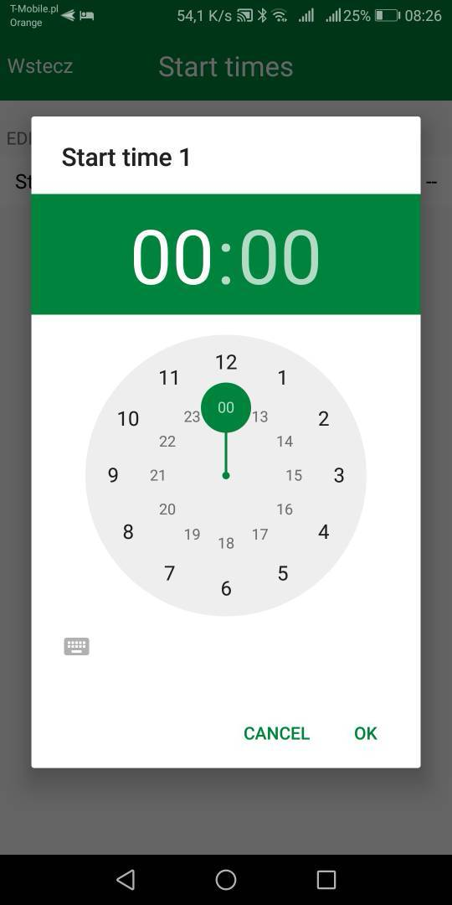
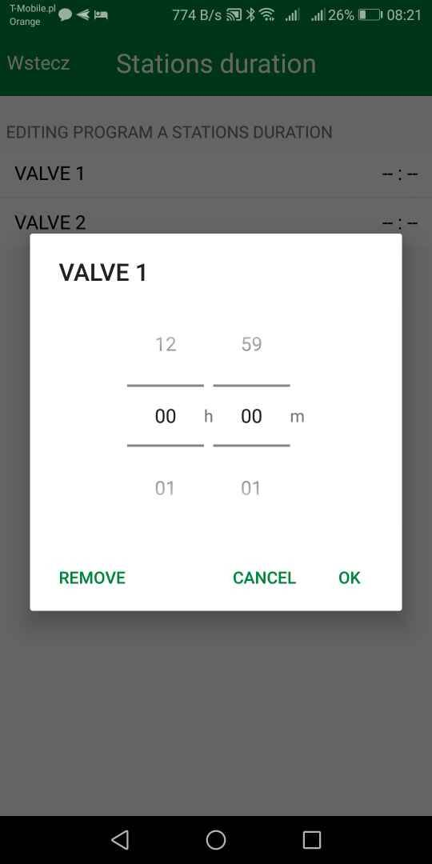
Водный Бюджет, время запуска и продолжительность полива
Notes:
The TBOS-BT provides flexible programming with many options:
There are three independent programs.
Each program can have up to eight start times per day.
There are four water day options – custom day selection, even or odd days and cyclic
Delay watering from 1 to 14 days, when using a wired RSD Rain Sensor
Monthly seasonal adjust can reduce the number of trips to the controller by allowing you to increase or decrease the program times based on the season. Time can be set to zero if the program needs to be shut off in the winter months.

Slide 14
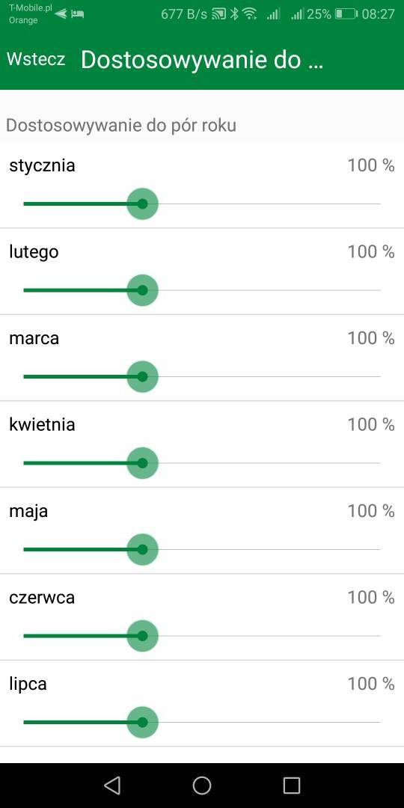
Сезонные настройки и задержка полива
Notes:
The TBOS-BT provides flexible programming with many options:
There are three independent programs.
Each program can have up to eight start times per day.
There are four water day options – custom day selection, even or odd days and cyclic
Delay watering from 1 to 14 days, when using a wired RSD Rain Sensor
Monthly seasonal adjust can reduce the number of trips to the controller by allowing you to increase or decrease the program times based on the season. Time can be set to zero if the program needs to be shut off in the winter months.

Slide 15
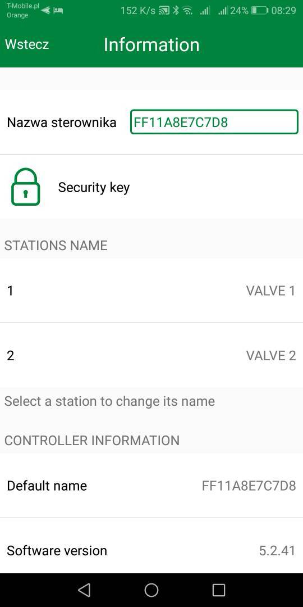
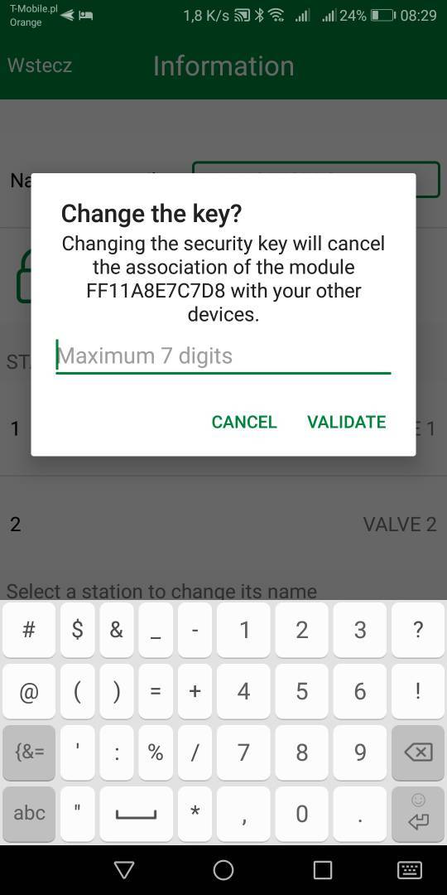
Установите пароль
Notes:
The TBOS-BT provides flexible programming with many options:
There are three independent programs.
Each program can have up to eight start times per day.
There are four water day options – custom day selection, even or odd days and cyclic
Delay watering from 1 to 14 days, when using a wired RSD Rain Sensor
Monthly seasonal adjust can reduce the number of trips to the controller by allowing you to increase or decrease the program times based on the season. Time can be set to zero if the program needs to be shut off in the winter months.

Slide 16
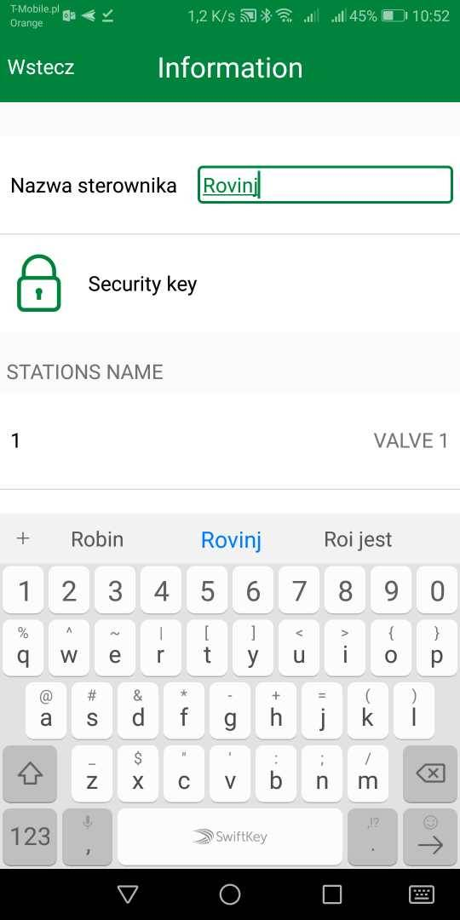
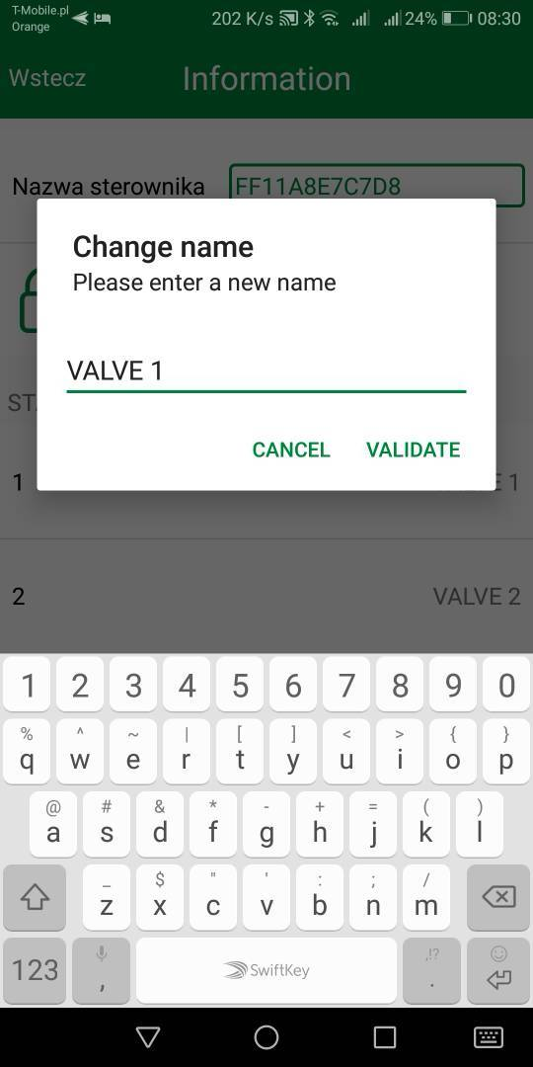
Дайте название контроллеру и клапанам
Notes:
The TBOS-BT provides flexible programming with many options:
There are three independent programs.
Each program can have up to eight start times per day.
There are four water day options – custom day selection, even or odd days and cyclic
Delay watering from 1 to 14 days, when using a wired RSD Rain Sensor
Monthly seasonal adjust can reduce the number of trips to the controller by allowing you to increase or decrease the program times based on the season. Time can be set to zero if the program needs to be shut off in the winter months.

